Slide 1

UNIVERSITY CASE STUDY USING SQL
by Antony Raj Victor

Slide 2
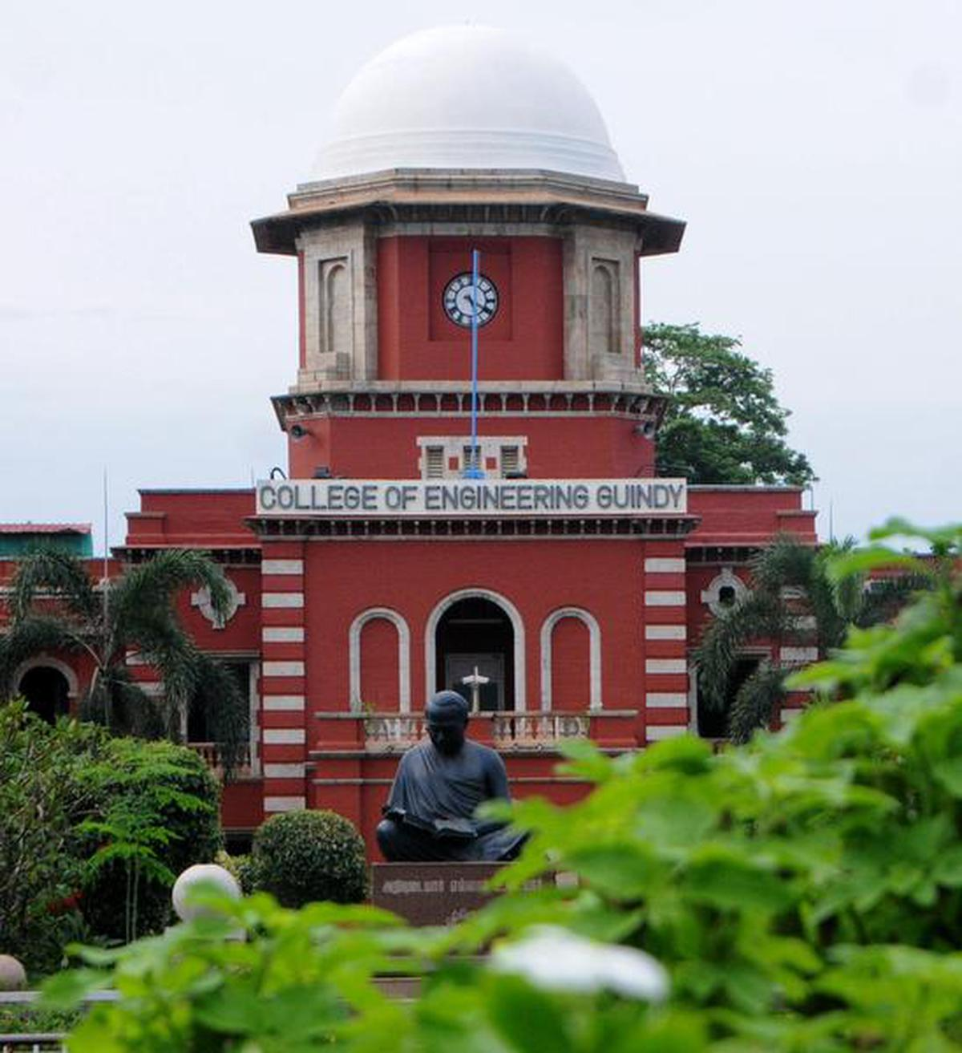
OVERVIEW
The case study consists of 11 University tables.
The tables provide information of students, instructors, course, section, time slot etc.
The goal of this case study is to assist the institution in increasing its growth and efficiency.
This case study includes SQL queries ranging from basic to complex.

Slide 3
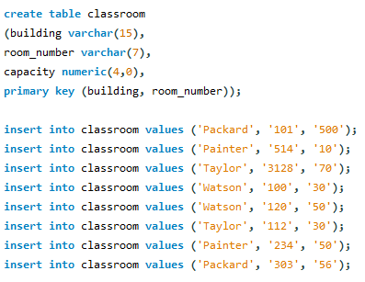
Classroom table
building | room_number | capacity
Packard | 101 | 500
Packard | 303 | 56
Painter | 234 | 50
Painter | 514 | 10
Taylor | 112 | 30
Taylor | 3128 | 70
Watson | 100 | 30
Watson | 120 | 50

Slide 4
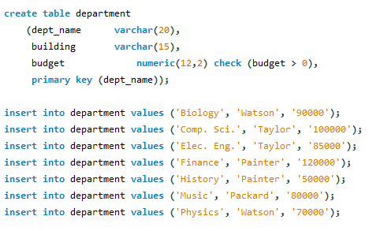
Department table
dept_name | building | budget
Biology | Watson | 91000
Comp. Sci. | Taylor | 101000
Elec. Eng. | Taylor | 86000
Finance | Painter | 121000
History | Painter | 51000
Music | Packard | 81000
Physics | Watson | 71000

Slide 5
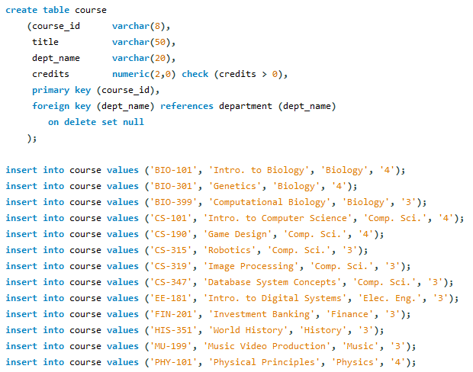
Course table
course_id | title | dept_name | credits
BIO-101 | Intro. to Biology | Biology | 4
BIO-301 | Genetics | Biology | 4
BIO-399 | Computational Biology | Biology | 3
CS-101 | Intro. to Computer Science | Comp. Sci. | 4
CS-190 | Game Design | Comp. Sci. | 4
CS-315 | Robotics | Comp. Sci. | 3
CS-319 | Image Processing | Comp. Sci. | 3
CS-347 | Database System Concepts | Comp. Sci. | 3
EE-181 | Intro. to Digital Systems | Elec. Eng. | 3
FIN-201 | Investment Banking | Finance | 3
HIS-351 | World History | History | 3
MU-199 | Music Video Production | Music | 3
PHY-101 | Physical Principles | Physics | 4

Slide 6
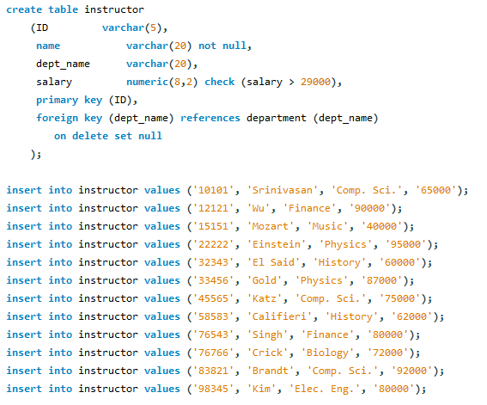
Instructor table
ID | name | dept_name | salary
10101 | Srinivasan | Comp. Sci. | 71500
12121 | Wu | Finance | 99000
15151 | Mozart | Music | 44000
22222 | Einstein | Physics | 95000
32343 | El Said | History | 66000
33456 | Gold | Physics | 95700
45565 | Katz | Comp. Sci. | 82500
58583 | Califieri | History | 68200
76543 | Singh | Finance | 88000
76766 | Crick | Biology | 79200
83821 | Brandt | Comp. Sci. | 92000
98345 | Kim | Elec. Eng. | 88000

Slide 7
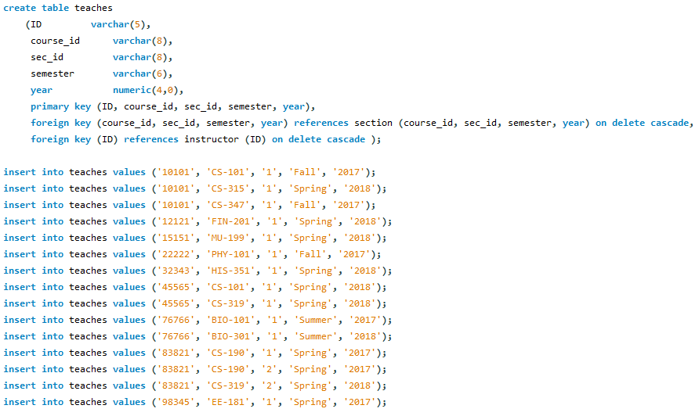
Teaches table

Slide 8
Teaches table
ID | course_id | sec_id | semester | year
76766 | BIO-101 | 1 | Summer | 2017
76766 | BIO-301 | 1 | Summer | 2018
10101 | CS-101 | 1 | Fall | 2017
45565 | CS-101 | 1 | Spring | 2018
83821 | CS-190 | 1 | Spring | 2017
83821 | CS-190 | 2 | Spring | 2017
10101 | CS-315 | 1 | Spring | 2018
45565 | CS-319 | 1 | Spring | 2018
83821 | CS-319 | 2 | Spring | 2018
10101 | CS-347 | 1 | Fall | 2017
98345 | EE-181 | 1 | Spring | 2017
12121 | FIN-201 | 1 | Spring | 2018
32343 | HIS-351 | 1 | Spring | 2018
15151 | MU-199 | 1 | Spring | 2018
22222 | PHY-101 | 1 | Fall | 2017

Slide 9
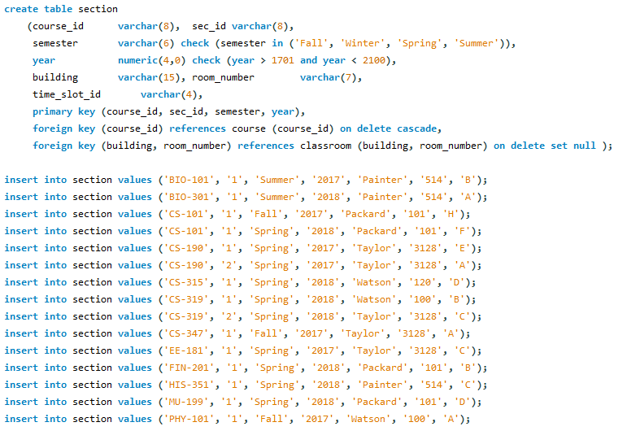
Section table

Slide 10
Section table
course_id | sec_id | semester | year | building | room_number | time_slot_id
BIO-101 | 1 | Summer | 2017 | Painter | 514 | B
BIO-301 | 1 | Summer | 2018 | Painter | 514 | A
CS-101 | 1 | Fall | 2017 | Packard | 101 | H
CS-101 | 1 | Spring | 2018 | Packard | 101 | F
CS-190 | 1 | Spring | 2017 | Taylor | 3128 | E
CS-190 | 2 | Spring | 2017 | Taylor | 3128 | A
CS-315 | 1 | Spring | 2018 | Watson | 120 | D
CS-319 | 1 | Spring | 2018 | Watson | 100 | B
CS-319 | 2 | Spring | 2018 | Taylor | 3128 | C
CS-347 | 1 | Fall | 2017 | Taylor | 3128 | A
EE-181 | 1 | Spring | 2017 | Taylor | 3128 | C
FIN-201 | 1 | Spring | 2018 | Packard | 101 | B
HIS-351 | 1 | Spring | 2018 | Painter | 514 | C
MU-199 | 1 | Spring | 2018 | Packard | 101 | D
PHY-101 | 1 | Fall | 2017 | Watson | 100 | A

Slide 11
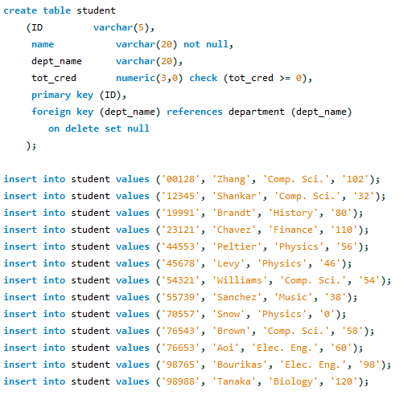
Student table
ID | name | dept_name | tot_cred
128 | Zhang | Comp. Sci. | 102
12345 | Shankar | Comp. Sci. | 32
19991 | Brandt | History | 80
23121 | Chavez | Finance | 110
44553 | Peltier | Physics | 56
45678 | Levy | Physics | 46
54321 | Williams | Comp. Sci. | 54
55739 | Sanchez | Music | 38
70557 | Snow | Physics | 0
76543 | Brown | Comp. Sci. | 58
76653 | Aoi | Elec. Eng. | 60
98765 | Bourikas | Elec. Eng. | 98
98988 | Tanaka | Biology | 120

Slide 12
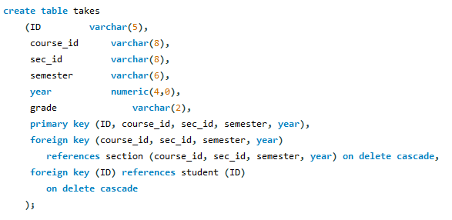
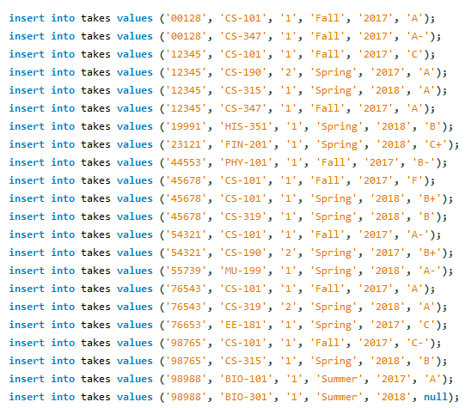
Takes table

Slide 13
Takes table
ID | course_id | sec_id | semester | year | grade
128 | CS-101 | 1 | Fall | 2017 | A
128 | CS-347 | 1 | Fall | 2017 | A-
12345 | CS-101 | 1 | Fall | 2017 | C
12345 | CS-190 | 2 | Spring | 2017 | A
12345 | CS-315 | 1 | Spring | 2018 | A
12345 | CS-347 | 1 | Fall | 2017 | A
19991 | HIS-351 | 1 | Spring | 2018 | B
23121 | FIN-201 | 1 | Spring | 2018 | C+
44553 | PHY-101 | 1 | Fall | 2017 | B-
45678 | CS-101 | 1 | Fall | 2017 | F
45678 | CS-101 | 1 | Spring | 2018 | B+
45678 | CS-319 | 1 | Spring | 2018 | B
54321 | CS-101 | 1 | Fall | 2017 | A-
54321 | CS-190 | 2 | Spring | 2017 | B+
55739 | MU-199 | 1 | Spring | 2018 | A-
76543 | CS-101 | 1 | Fall | 2017 | A
76543 | CS-319 | 2 | Spring | 2018 | A
76653 | EE-181 | 1 | Spring | 2017 | C
98765 | CS-101 | 1 | Fall | 2017 | C-
98765 | CS-315 | 1 | Spring | 2018 | B
98988 | BIO-101 | 1 | Summer | 2017 | A
98988 | BIO-301 | 1 | Summer | 2018 | NULL

Slide 14
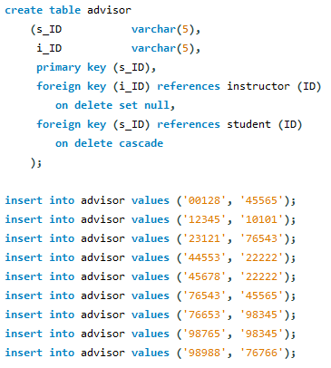
Advisor table
s_ID | i_ID
12345 | 10101
44553 | 22222
45678 | 22222
128 | 45565
76543 | 45565
23121 | 76543
98988 | 76766
76653 | 98345
98765 | 98345

Slide 15
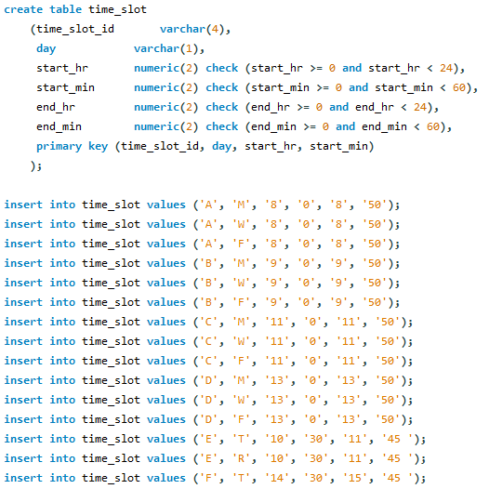
Time_slot table
time_slot_id | day | start_hr | start_min | end_hr | end_min
A | F | 8 | 0 | 8 | 50
A | M | 8 | 0 | 8 | 50
A | W | 8 | 0 | 8 | 50
B | F | 9 | 0 | 9 | 50
B | M | 9 | 0 | 9 | 50
B | W | 9 | 0 | 9 | 50
C | F | 11 | 0 | 11 | 50
C | M | 11 | 0 | 11 | 50
C | W | 11 | 0 | 11 | 50
D | F | 13 | 0 | 13 | 50
D | M | 13 | 0 | 13 | 50
D | W | 13 | 0 | 13 | 50
E | R | 10 | 30 | 11 | 45
E | T | 10 | 30 | 11 | 45
F | R | 14 | 30 | 15 | 45
F | T | 14 | 30 | 15 | 45
G | F | 16 | 0 | 16 | 50
G | M | 16 | 0 | 16 | 50
G | W | 16 | 0 | 16 | 50
H | W | 10 | 0 | 12 | 30

Slide 16
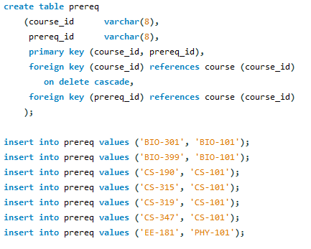
Prerequisite table
course_id | prereq_id
BIO-301 | BIO-101
BIO-399 | BIO-101
CS-190 | CS-101
CS-315 | CS-101
CS-319 | CS-101
CS-347 | CS-101
EE-181 | PHY-101

Slide 17

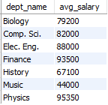
Problem 1
Display average salary given by each department.
Solution:
select dept_name, round(avg(salary)) as avg_salary from instructor
group by dept_name;

Slide 18
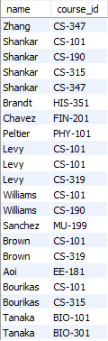
Problem 2
2. Display the name of students and their corresponding course IDs.
Solution:
select name,course_id
from takes,student
where student.id=takes.id;

Slide 19
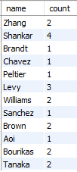
Problem 3
3. Display number of courses taken by each student.
Solution:
select name,count(course_id) as 'count'
from takes,student
where student.id=takes.id
group by name;

Slide 20
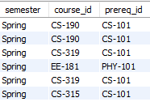
Problem 4
4. Get the prerequisites courses for courses in the Spring semester.
Solution:
select semester,s.course_id,prereq_id
from section s,prereq p
where s.course_id=p.course_id
and semester='spring';

Slide 21
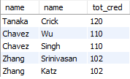
Problem 5
5. Display the instructor name who teaches student with highest 5 credits
Solution:
select s.name,i.name,tot_cred
from student s join instructor i
using (dept_name)
order by tot_cred desc
limit 5;

Slide 22

Problem 6
6. Which semester and department offers maximum number of courses
Solution:
select semester, dept_name, max(count) as max_courses
from
(select semester, dept_name, count(course_id) as count
from course join section using(course_id)
group by dept_name )
as one;

Slide 23

Problem 7
7. Display course and department whose time starts at 8.
Solution:
select distinct course_id,start_hr as hour
from time_slot join section using(time_slot_id)
where start_hr=8;

Slide 24

Problem 8
8. Display the salary of instructors from Watson building.
Solution:
select name,salary,building from instructor join department using(dept_name) where building='watson';

Slide 25
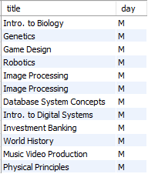
Problem 9
9. Show the title of courses available on Monday.
Solution:
select title, day
from time_slot join section
using (time_slot_id) join course
using (course_id) where day='m';

Slide 26

Problem 10
10. Find the number of courses that start at 8 and end at 8.
Solution:
select start_hr, end_hr,
count(course_id) as numer_of_courses
from section join time_slot
using(time_slot_id)
where start_hr=8 and end_hr=8 ;

Slide 27

Problem 11
11. Find instructors having salary more than 90000.
Solution:
select name,salary
from instructor
where salary>90000;

Slide 28
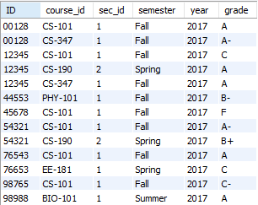
Problem 12
12. Find student records taking courses before 2018.
Solution:
select * from takes
where year<2018;

Slide 29
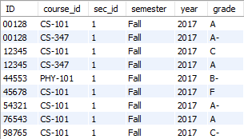
Problem 13
13. Find student records taking courses in the fall semester and coming under first section.
Solution:
select * from takes
where semester='fall' and sec_id=1;

Slide 30
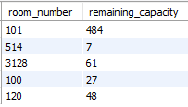
Problem 14
14. Find the number of capacity left after occupying all the students.
Solution:
select section.room_number,
capacity-count (classroom.room_number) as remaining_capacity
from student, takes, section, classroom
where student.id=takes.id and
takes.course_id=section.course_id
and section.room_number = classroom.room_number
group by capacity;

Slide 31

Problem 15
15. Find student records taking courses in the summer semester, coming under first section in the year 2017.
Solution:
select * from takes
where semester='summer' and sec_id=1
and year=2017;

Slide 32
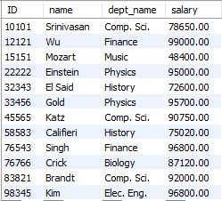
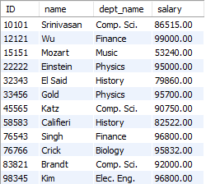
Problem 16
16.Increase(update) the salary of each instructor by 10% if their current salary is between 0 and 90000.
before update →
Solution:
update instructor set salary=salary*1.1
where salary between 0 and 90000;

Slide 33

Problem 17
17.Find the number of courses having A grade in each building.
Solution:
select building, count(course_id) as course_count
grade from takes join section
using(course_id)
where grade='A'
group by building;

Slide 34

Problem 18
18. Display section details with B time slot, room number 514 and in the Painter building.
Solution:
select sec_id, time_slot_id,
room_number, building
from section
where time_slot_id='B'
and room_number=514
and building='Painter';

Slide 35

Problem 19
19. Find all course titles which have a string "Intro“.
Solution:
select title from course
where title REGEXP '^intro';

Slide 36

Problem 20
20. Find the titles of courses in the Computer Science department that have 3 credits.
Solution:
select title, credits, dept_name
from course
where dept_name='Comp. Sci.'
and credits=3;

Slide 37

Problem 21
21. Find IDs and titles of all the courses which were taught by an instructor named Einstein.
Solution:
select course_id, title, name
from course join instructor
using (dept_name)
where name='Einstein';

Slide 38

Problem 22
22. Find all course IDs which start with CS.
Solution:
select course_id from course
where course_id regexp '^cs';

Slide 39
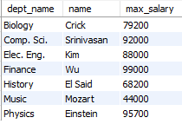
Problem 23
23. For each department, find the maximum salary of instructors in that department.
Solution:
Select dept_name, name,
round(max(salary)) as max_salary
from instructor
group by dept_name;

Slide 40

Problem 24
24. Display number of students in each department having total credits divisible by course credits.
Solution:
select count(s.id) as 'no_of_students’,
s.dept_name, name, tot_cred, credits
from student s , course c
where s.dept_name = c.dept_name and
tot_cred/credits=0
group by c.dept_name;

Slide 41

Problem 25
25. Find number of instructors in each department having 'a' and 'e' in their name.
Solution:
select dept_name,
count(name) as inst_count, name
from instructor
where name like '%a%e%'
group by dept_name;

Slide 42

Problem 26
26. Display number of courses being taught in classroom having capacity more than 20.
Solution:
select s.room_number,
count(course_id)as number_of_courses,
s.building, capacity
from classroom c join section s
where c.room_number=s.room_number
and capacity>20;

Slide 43

Problem 27
27. Display number of students in each semester and their sum of credits.
Solution:
select semester,count(id) as count_of_students,
sum(tot_cred) as total_credits
from takes join student using(id)
group by semester;

Slide 44

Problem 28
28. Display advisor IDs for instructors in Painter building.
Solution:
select distinct(building), name, s_id, i_id as inst_id
from section, teaches, advisor, instructor where advisor.i_id=instructor.id
and
instructor.id=teaches.ID
and
teaches.course_id=section.course_id
and
building='painter';

Slide 45

Problem 29
29. Find total credits earned by students coming at 9am.
Solution:
select name ,dept_name, start_hr ,
tot_cred as Total_Credits
from time_slot t ,student s ,section c ,takes ta
where c.time_slot_id=t.time_slot_id
and
c.course_id=ta.course_id and ta.id=s.ID
and
start_hr=9
group by c.course_id;

Slide 46
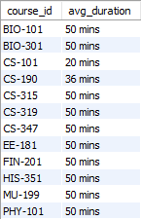
Problem 30
30. Find the average duration of classes for each course id.
Solution:
select course_id, avg(end_min-start_min)
from section,time_slot
where section.time_slot_id=time_slot.time_slot_id
group by course_id;
with avg_duration as(
select time_slot_id, ( end_min - start_min) as duration
from time_slot )
select course_id, concat(round(avg(duration)),' mins')
as avg_duration from avg_duration a join section s
on a.time_slot_id = s.time_slot_id
group by course_id;

Slide 47
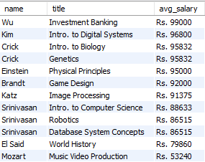
Problem 31
31. Find the average salary that's distributed to teachers for each course and sort them in descending order.
Solution:
with course_data as
(select id , title from teaches t join course c
on t.course_id=c.course_id )
select title , avg(salary) as avg_salary
from course_data cd join instructor i on cd.id = i.id
group by title
order by avg_salary desc;
select title, concat('Rs. ',round(avg(salary))) as avg_salary
from teaches t,course c,instructor i
where t.course_id=c.course_id and i.ID=t.ID
group by title
order by avg_salary desc;

